Slide 1
CLASSIFICATION (cont.)
Main reference: Chapter 3 of Géron, A. (2019). Hands-on machine learning with Scikit-Learn, Keras, and TensorFlow.

Slide 2





Multiclass classification

Slide 3









Multiclass classification strategies
One-versus-all: N classes ➔
One-versus-one: N classes ➔
Advantage of OvO:

Slide 4

Multiclass classification strategies
Most binary classifiers:
SVM classifiers:

Slide 6

To reduce the false 8s
Some suggestions:
Gather more training data for
Count the number of closed loops
Preprocess the images (e.g., using Scikit-Image, Pillow, or OpenCV)

Slide 7


3s and 5s images
SGDClassifier is a linear model.
All it does is
So since 3s and 5s differ only by a few pixels,

Slide 9















Multilabel Classification

Slide 10
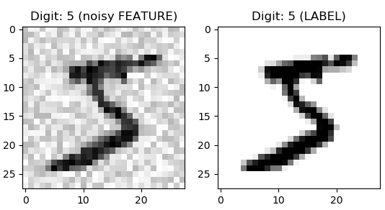





Multioutput Classification

